Slide 1


Slide 2
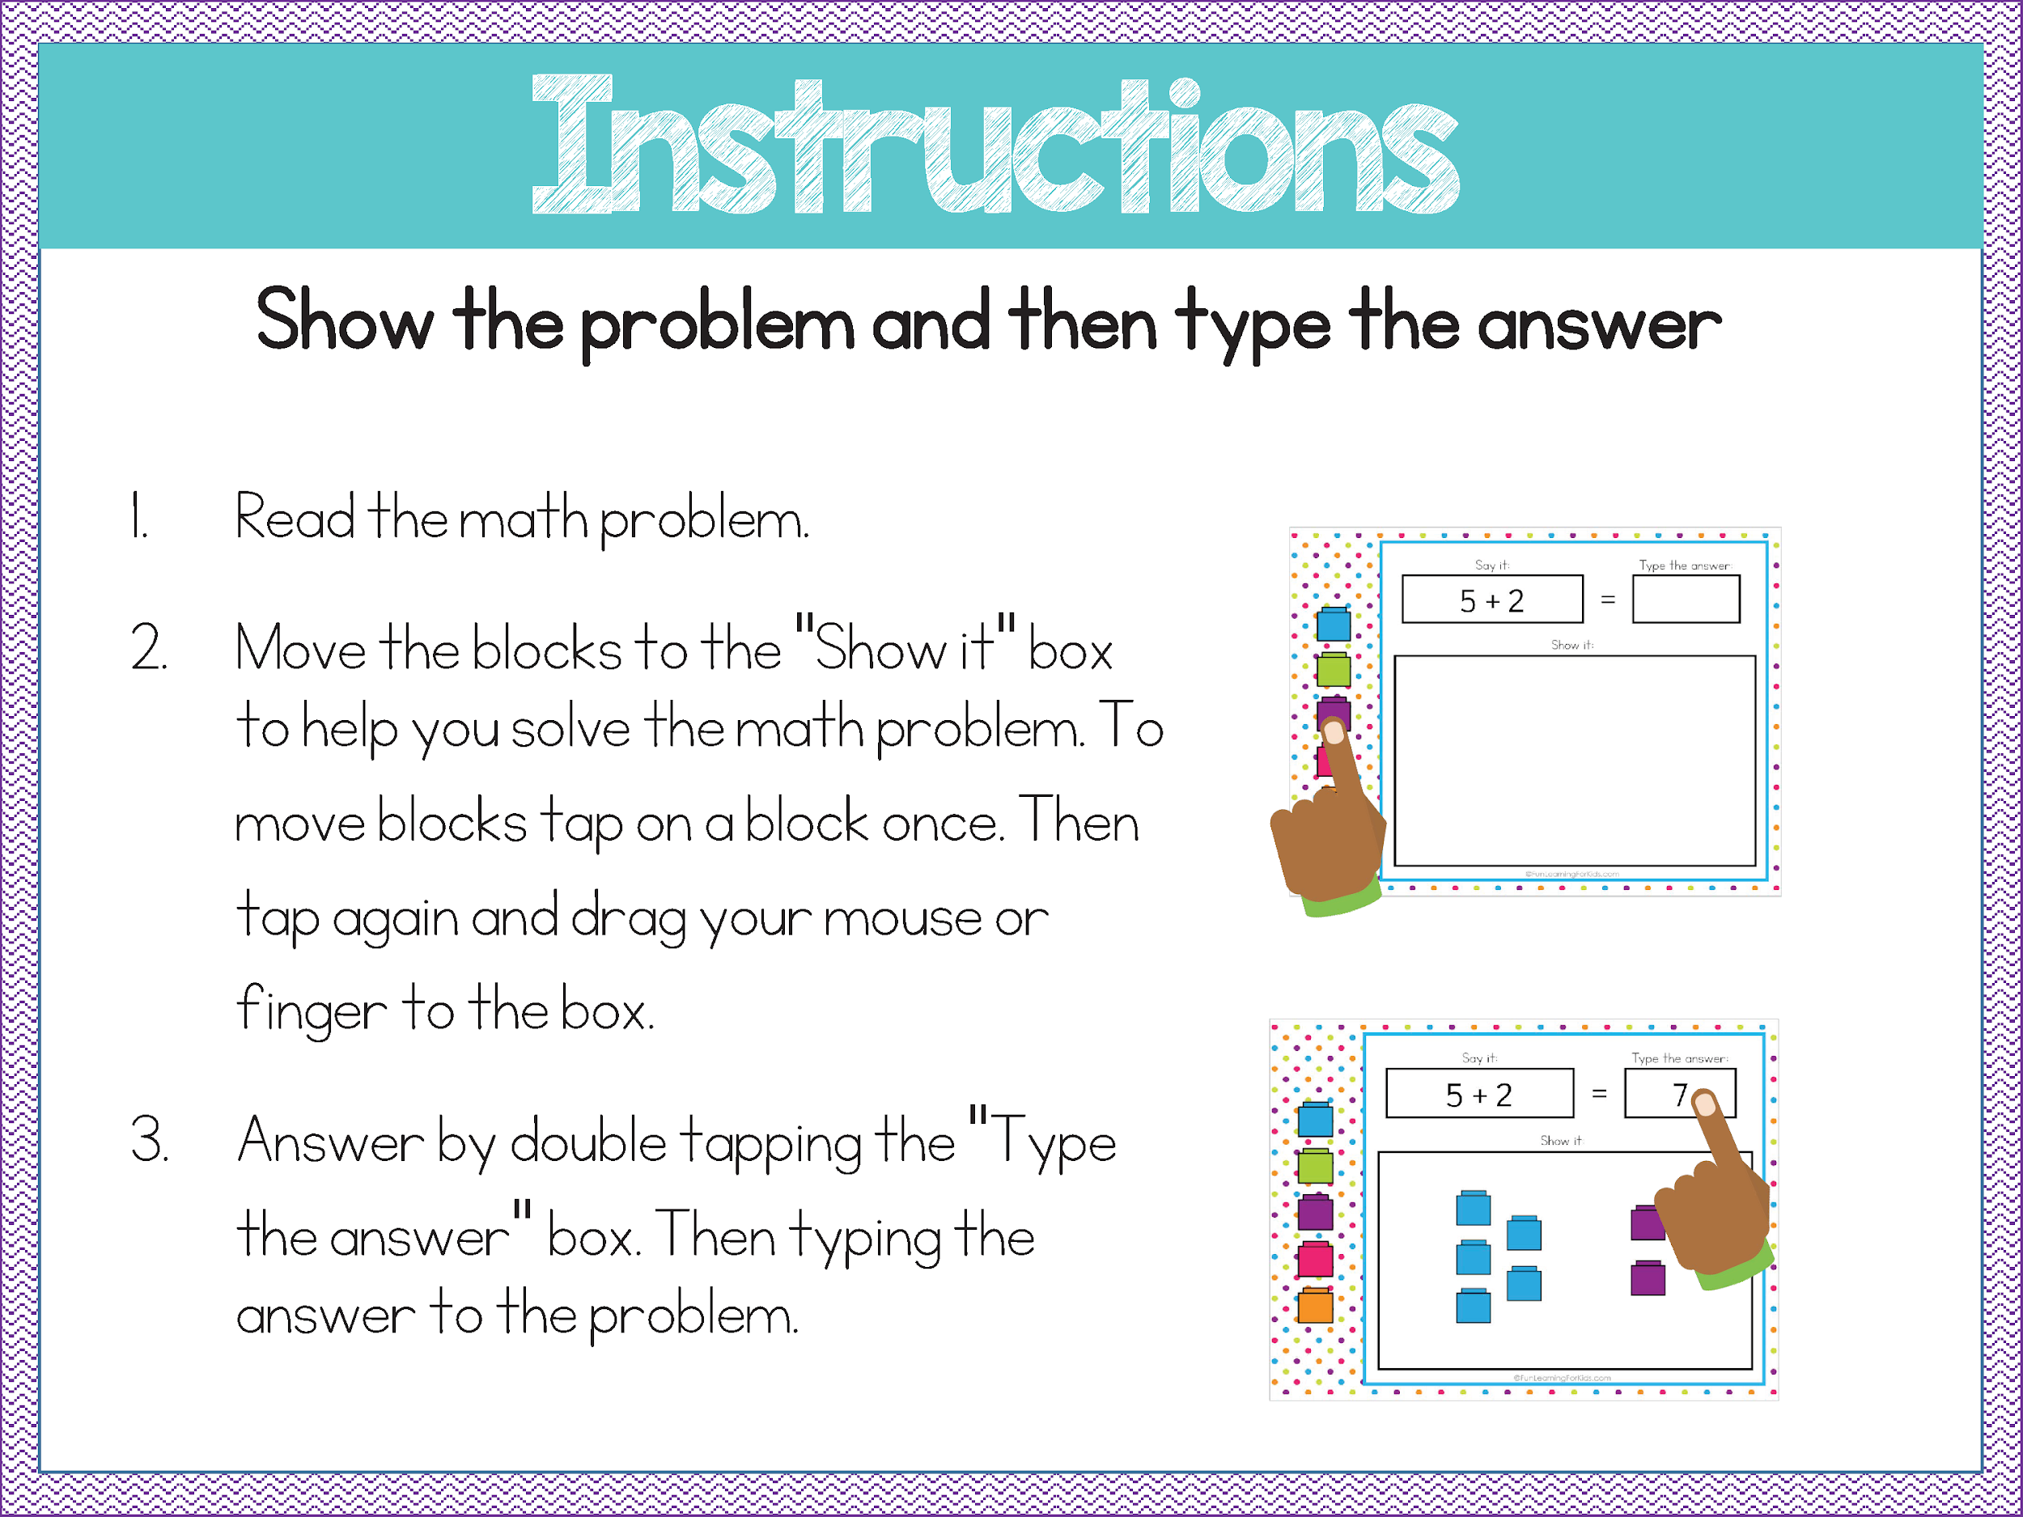

Slide 3
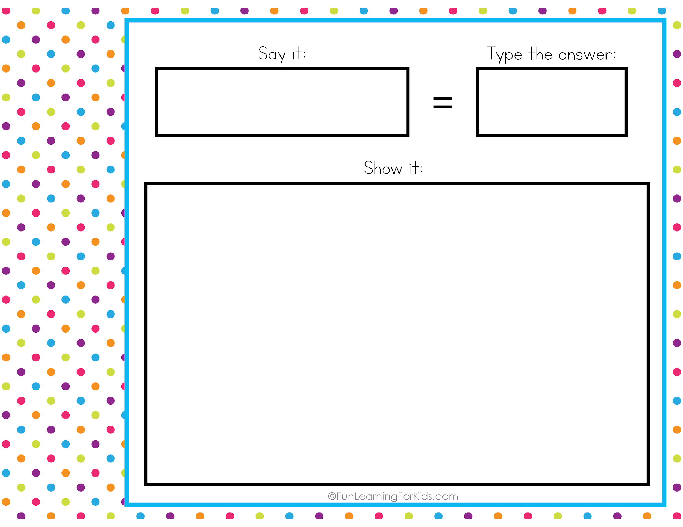





2 and 3
5

Slide 4
9 and 1

Slide 5
4 and 4

Slide 6
5 and 4

Slide 7
3 and 7

Slide 8
4 and 1

Slide 9
2 and 1

Slide 10
4 and 6

Slide 11
6 and 2

Slide 12
5 and 5

Slide 13
2 and 2

Slide 14
8 and 2

Slide 15
5 and 3

Slide 16
3 and 3

