Slide 1


To use this activity:
~ be in edit mode, not the slide show presentation
~ if you are on an iPad or phone, click the images one time to activate them and another time to drag them
Please reach out to your teacher if you have any other issues using the file.
Have fun!

Slide 2
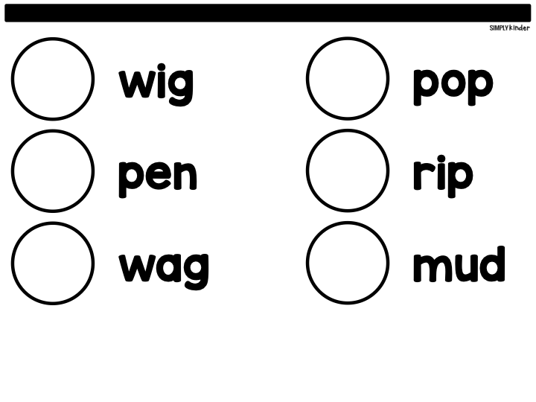







I CAN READ SHORT VOWEL WORDS.
Drag the picture to match the word.

Slide 3
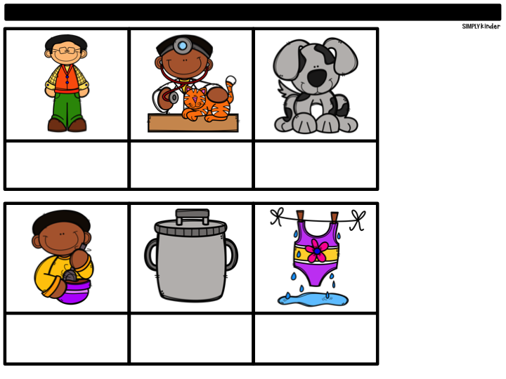






I CAN READ SHORT VOWEL WORDS.
Drag the word under the matching picture.

Slide 4
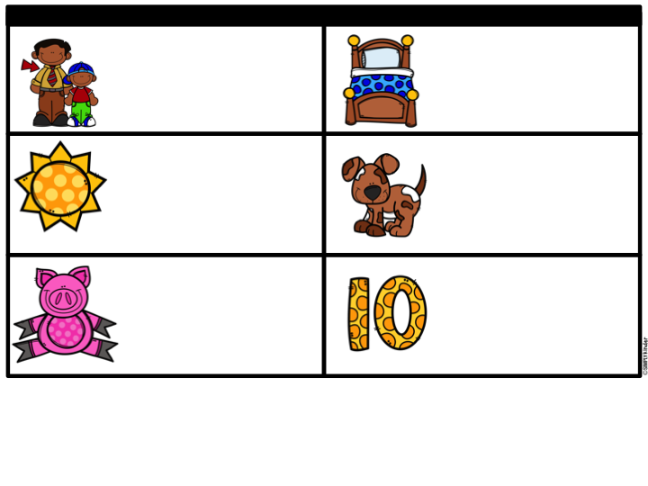












I CAN WRITE SHORT VOWEL WORDS
Drag the letters to write the words.

Slide 5
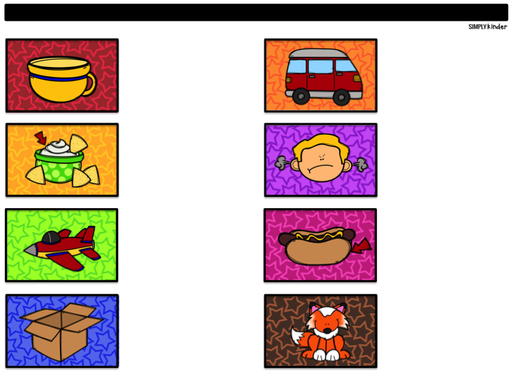

I CAN WRITE SHORT VOWEL WORDS
Click in the blue box to type the word.

Slide 6
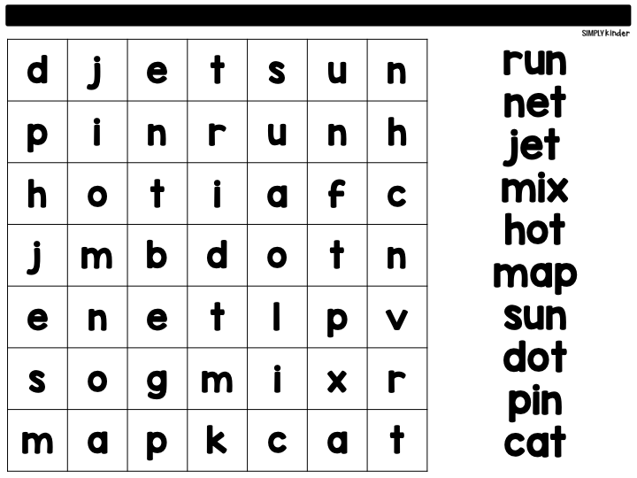
I CAN READ SHORT VOWEL WORDS
Click and drag the color over the word.

Slide 7
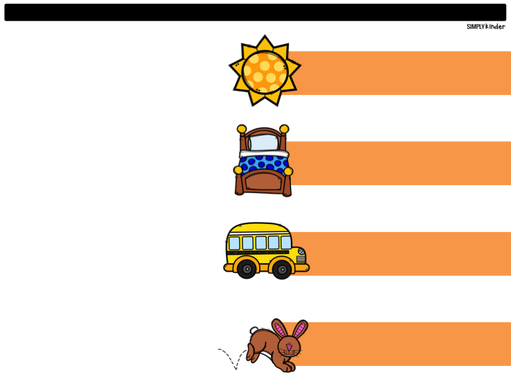




I CAN READ SENTENCES
Drag the sentence to the right picture.

Slide 8

I CAN WRITE SENTENCES
Click in the blue box to write a sentence

